Slide 2
Welcome to the image bank, focusing on children and IC!
Here is a collection of images to tailor instructions on how to perform intermittent catheterization to the needs of each individual child. The goal is to help children learn to catheterize themselves – independently.
Just pick the picture of the person you think the child can best relate to, then create an instructional presentation using the images needed to illustrate what your patient needs to practice.
We hope the images will be of great support when it comes to teaching children to self-catheterize using a LoFric catheter.
Here's how to create an instruction for children to learn IC:
Select the images you want to use in your instruction.
Click on the image, and it will open in a new window.
Right click to save, or copy the image (so you can paste it into your uploaded print template).
Alternatively, click on the link and the image will be downloaded directly to your computer.

Slide 3
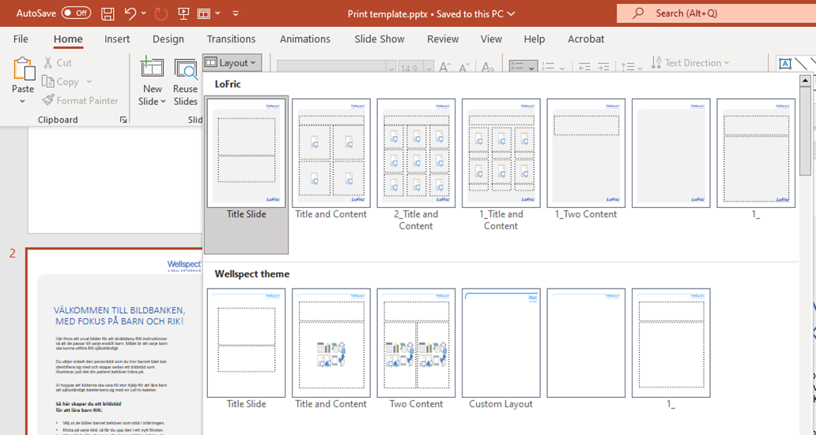
Choose Layout
Add slide (New Slide), or change layout for different options
Delete this slide

